Slide 1


HEART DISEASE PREDICTION USING ML
01
22MCA0137- KANISHK SHARMA
22MCA0174 - UDDASHAY KUMAR GUPTA

Slide 2

Introduction
03
Part 01

Slide 3


About Heart Disease
According to the World Health Organization, every year 12 million deaths occur worldwide due to heart disease. Heart disease is one of the biggest causes of morbidity and mortality among the population of the world. Prediction of cardiovascular disease is regarded as one of the most important subjects in the section of data analysis. The load of cardiovascular disease is rapidly increasing all over the world from the past few years.
Even though heart disease can occur in different forms, there is a common set of core risk factors that influence whether someone will ultimately be at risk for heart disease or not. By collecting the data from various sources, classifying them under suitable headings & finally analyzing to extract the desired data we can say that this technique can be very well adapted to do the prediction of heart disease.
A QUICK INTRO ABOUT HEART DISEASE

Slide 4

Background
Overview of the project
Machine Learning has found widespread applications in various industries worldwide, including the healthcare sector. With its potential to analyze large datasets and make accurate predictions, Machine Learning can be utilized in predicting the presence, heart diseases, and other medical conditions. Early prediction of such diseases can provide valuable insights to healthcare professionals, enabling them to tailor their diagnoses and treatments on a per-patient basis. In this research project, our focus is on predicting possible heart diseases using Machine Learning algorithms. We conduct a comparative analysis of several popular classifiers, including decision tree, Naïve Bayes, logistic regression, support vector machine (SVM), and random forest.
04

Slide 5




The Problem
05
What we want to solve
Research
To predict Heart Disease using machine learning algorithms
We conduct a comparative analysis of several popular classifiers, including decision tree, Naïve Bayes, logistic regression, support vector machine (SVM), and random forest.

Slide 6
Significance
of the Project
It has a wide scope in the field of Healthcare sector. As in many countries, the healthcare systems have already been overwhelmed and the manual thorough study is time-consuming. Hence, a number of physicians uses rough
measures for the evaluation, this demands into the automation.
07

Slide 7





Key Opportunities
A favorable landscape
Urgency
Necessity
Timing
Support
Impact

Slide 8

Literature Review
08
Part 02

Slide 9
Research papers and their highlights
Highlight [1]
Data is directly retrieved from electronic records that reduce the manual tasks. Different algorithms of machine learning such as logistic regression and KNN are implemented to predict and classify the patient with heart disease.
Highlight [2]
The algorithms like SVM, KNN are results based on vertical or horizontal split conditions depends on dependent variables. They have also used Cleveland data set. Dataset splits in 70% training and 30% testing by using some methods. This algorithm gives 91% accuracy.
14
[1] Heart disease prediction using machine learning algorithms
[2] Prediction of Heart Disease Using Machine Learning Algorithms
[3] Machine Learning Techniques for Heart Disease Prediction
Highlight [3]
Lakshmana Rao proposed “Machine Learning Techniques for Heart Disease Prediction” in which the contributing elements for heart disease are more. So, it is difficult to distinguish heart disease. To find the seriousness of the heart disease among people different neural systems and data mining techniques are used.

Slide 10


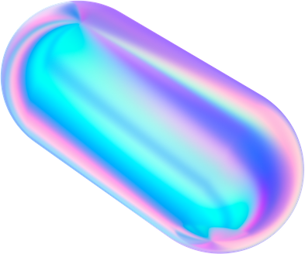

Proposed Work
In this project, various machine learning algorithms like SVM, Naive Bayes, Decision Tree, Random Forest, Logistic Regression, Adaboost, XG-boost are used to predict heart disease. Heart Disease UCI dataset, has a total of 76 attributes, out of those only 14 attributes are considered for the prediction of heart disease. Various attributes of the patient like gender, chest pain type, fasting blood pressure, serum cholesterol, exang, etc are considered for this project. The accuracy for individual algorithms has to measure and whichever algorithm is giving the best accuracy,that is considered for the heart disease prediction. For evaluating the experiment, various evaluation metrics like accuracy, confusion matrix, precision, recall, and f1-score are considered.
CONCLUSION OF LITERATURE REVIEW

Slide 11
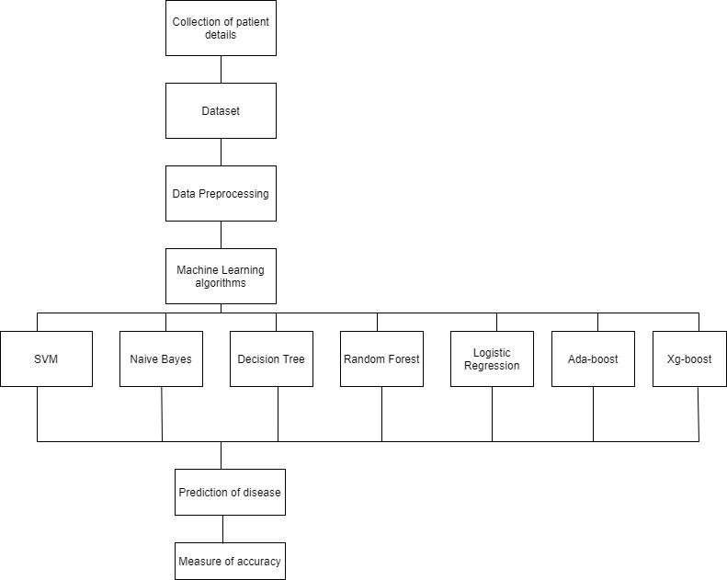

Slide 12
Methodology
08
Part 03

Slide 13

Overview of Research Methods
In this research, we developed a CNN architecture, using VGG-16 as base model by implementing transfer learning and a custom CNN has been used as the output layer. To improve the accuracy, Gray Wolf Optimizer has been used to identify the ideal the hyper-parameters for the CNN to detect brain tumor in the MRI scans.

Slide 14
NAIVE BAYES ALGORITHM:
Naive Bayes Classifier is one of the simple and most effective Classification algorithms which helps in building the fast machine learning models that can make quick predictions. It is a probabilistic classifier, which means it predicts on the basis of the probability of an object. Some popular examples of Naïve Bayes Algorithm are spam filtration, Sentimental analysis, and classifying articles. It is a classification technique based on Bayes’ Theorem with an assumption of independence among predictors. In simple terms, a Naive Bayes classifier assumes that the presence of a particular feature in a class is unrelated to the presence of any other feature.
The Naive Bayes model is easy to build and particularly useful for very large data sets. Along with simplicity, Naive Bayes is known to outperform even highly sophisticated classification methods.

Slide 15
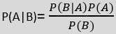
NAIVE BAYES ALGORITHM:
Bayes’s theorem:
Bayes' theorem is also known as Bayes' Rule or Bayes' law, which is used to determine the probability of a hypothesis with prior knowledge. It depends on the conditional probability
Where,
P(A|B) is Posterior probability:Probability of hypothesis A on the observed event B.
P(B|A) is Likelihood probability: Probability of the evidence given that the probability of a hypothesis is true.
P(A) is Prior Probability: Probability of hypothesis before observing the evidence. P(B) is Marginal Probability: Probability of Evidence.

Slide 16
DECISION TREE ALGORITHM
Decision Tree is a Supervised learning technique that can be used for both classification and regression problems, but mostly it is preferred for solving classification problems. It is a tree- structured classifier, where internal nodes represent the features of a dataset, branches represent the decision rules and each leaf node represents the outcome. In a Decision Tree, there are two nodes, which are the Decision Node and Leaf Node.
In a Decision Tree, for predicting the class of the given dataset, the algorithm starts from the root node of the tree. This algorithm compares the values of the root attribute with the record (real dataset) attribute and, based on the comparison, follows the branch and jumps to the next node.
For the next node, the algorithm again compares the attribute value with the other sub-nodes and moves further. It continues the process until it reaches the leaf node of the tree.

Slide 17
DECISION TREE ALGORITHM
The complete process can be better understood using the below algorithm:
● Step-1: Begin the tree with the root node, says S, which contains the complete dataset.
● Step-2: Find the best attribute in the dataset using Attribute Selection Measure (ASM).
● Step-3: Divide the S into subsets that contains possible values for the best attributes.
● Step-4: Generate the Decision Tree node, which contains the best attribute.
● Step-5: Recursively make new decision trees using the subsets of the dataset created in step -3. Continue this process until a stage is reached where you cannot further classify the nodes and call the final node as a leaf node.

Slide 18
RANDOM FOREST ALGORITHM
Random Forest is a supervised learning algorithm. It is an extension of machine learning classifiers which include the bagging to improve the performance of Decision Tree. It combines tree predictors, and trees are dependent on a random vector which is independently sampled. The distribution of all trees are the same. Random Forests splits nodes using the best among of a predictor subset that are randomly chosen from the node itself, instead of splitting nodes based on the variables. The time complexity of the worst case of learning with Random Forests is O(M(dnlogn)) , where M is the number of growing trees, n is the number of instances, and d is the data dimension.
As the name suggests, "Random Forest is a classifier that contains a number of decision trees on various subsets of the given dataset and takes the average to improve the predictive accuracy of that dataset." Instead of relying on one decision tree, the random forest takes the prediction from each tree and based on the majority votes of predictions, and it predicts the final output.
The greater number of trees in the forest leads to higher accuracy and prevents the problem of overfitting.

Slide 19
DECISION TREE ALGORITHM
Decision Tree is a Supervised learning technique that can be used for both classification and regression problems, but mostly it is preferred for solving classification problems. It is a tree- structured classifier, where internal nodes represent the features of a dataset, branches represent the decision rules and each leaf node represents the outcome. In a Decision Tree, there are two nodes, which are the Decision Node and Leaf Node.
In a Decision Tree, for predicting the class of the given dataset, the algorithm starts from the root node of the tree. This algorithm compares the values of the root attribute with the record (real dataset) attribute and, based on the comparison, follows the branch and jumps to the next node.
For the next node, the algorithm again compares the attribute value with the other sub-nodes and moves further. It continues the process until it reaches the leaf node of the tree.

Slide 20
DECISION TREE ALGORITHM
Algorithm Steps:
It works in four steps:
● Select random samples from a given dataset.
● Construct a Decision Tree for each sample and get a prediction result from each Decision Tree.
● Perform a vote for each predicted result.
● Select the prediction result with the most votes as the final prediction.

Slide 21
LOGISTIC REGRESSION ALGORITHM
Logistic regression is one of the most popular Machine Learning algorithms, which comes under the Supervised Learning technique. It is used for predicting the categorical dependent variable using a given set of independent variables.
Logistic regression predicts the output of a categorical dependent variable. Therefore, the outcome must be a categorical or discrete value. It can be either Yes or No, 0 or 1, true or False, etc. but instead of giving the exact value as 0 and 1, it gives the probabilistic values which lie between 0 and 1. Logistic Regression is much similar to the Linear Regression except that how they are used. Linear Regression is used for solving Regression problems, whereas logistic regression is used for solving the classification problems.
In Logistic regression, instead of fitting a regression line, we fit an "S"shaped logistic function, which predicts two maximum values (0 or 1). The curve from the logistic function indicates the likelihood of something such as whether the cells are cancerous or not, a mouse is obese or not based on its weight, etc.
Logistic Regression is a significant machine learning algorithm because it has the ability to provide probabilities and classify new data using continuous and discrete datasets.

Slide 22
ADABOOST ALGORITHM
Adaboost was the first really successful boosting algorithm developed for the purpose of binary classification. Adaboost is short for Adaptive Boosting and is a very popular boosting technique which combines multiple “weak classifiers” into a single “strong classifier”
> Algorithm:
1. Initially, Adaboost selects a training subset randomly.
2. It iteratively trains the Adaboost machine learning model by selecting the training set based on the accurate prediction of the last training.
3. It assigns the higher weight to wrong classified observations so that in the next iteration these observations will get the high probability for classification.
4. Also, it assigns the weight to the trained classifier in each iteration according to the
accuracy of the classifier. The more accurate classifier will get high weight.
5. This process iterates until the complete training data fits without any error or until reached to the specified maximum number of estimators.
6. To classify, perform a "vote" across all of the learning algorithms you built

Slide 23
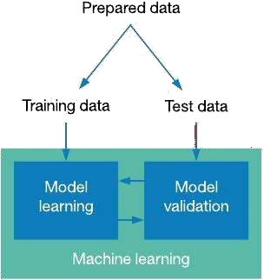
Dataset Splitting

Slide 24
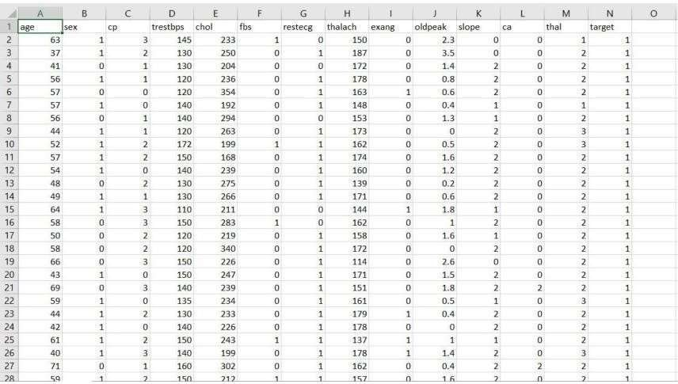
DATASET DETAILS
Of the 76 attributes available in the dataset,14 attributes are considered for the prediction of the output.
Heart Disease UCI : https://archive.ics.uci.edu/ml/datasets/Heart+Disease

Slide 25
S. No. | Attribute | Description | Type
1 | Age | Patient’s age (29 to 77) | Numerical
2 | Sex | Gender of patient(male-0 female-1) | Nominal
3 | Cp | Chest pain type | Nominal
4 | Trestbps | Resting blood pressure( in mm Hg on admission to hospital ,values from 94 to 200) | Numerical
5 | Chol | Serum cholesterol in mg/dl, values from 126 to 564) | Numerical
6 | Fbs | Fasting blood sugar>120 mg/dl, true- 1 false-0) | Nominal
7 | Resting | Resting electrocardiographics result (0 to 1) | Nominal
8 | Thali | Maximum heart rate achieved(71 to 202) | Numerical
9 | Exang | Exercise included agina(1-yes 0- no) | Nominal
10 | Oldpeak | ST depression introduced by exercise relative to rest (0 to .2) | Numerical
11 | Slope | The slop of the peak exercise ST segment (0 to 1) | Nominal
12 | Ca | Number of major vessels (0-3) | Numerical
13 | Thal | 3-normal | Nominal
14 | Targets | 1 or 0 | Nominal

Slide 26
PERFORMANCE ANALYSIS
In this project, various machine learning algorithms like SVM, Naive Bayes, Decision Tree, Random Forest, Logistic Regression, Adaboost, XG-boost are used to predict heart disease. Heart Disease UCI dataset, has a total of 76 attributes, out of those only 14 attributes are considered for the prediction of heart disease. Various attributes of the patient like gender, chest pain type, fasting blood pressure, serum cholesterol, exang, etc are considered for this project. The accuracy for individual algorithms has to measure and whichever algorithm is giving the best accuracy,that is considered for the heart disease prediction. For evaluating the experiment, various evaluation metrics like accuracy, confusion matrix, precision, recall, and f1-score are considered.
Accuracy- Accuracy is the ratio of the number of correct predictions to the total number of inputs in the dataset. It is expressed as:
Accuracy = (TP + TN) /(TP+FP+FN+TN)

Slide 27

Results
13
Part 03

Slide 28
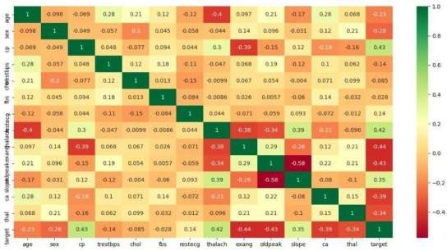
Correlation Matrix: The correlation matrix in machine learning is used for feature selection. It represents dependency between various attributes.

Slide 29
XG-boost is effective
THE OBSERVATION OFTHE MODEL

Slide 30
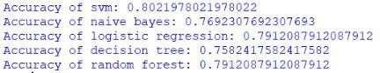
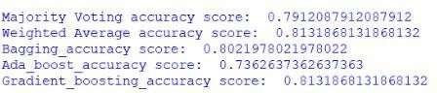
PERFORMANCE MEASURES
.
Higher it is better it is.
16

Slide 31
Conclusion
17
Part 04

Slide 32
Result
Algorithm | Accuracy
XG-boost | 81.3%
SVM | 80.2%
Logistic Regression | 79.1%
Random Forest | 79.1%
Naive Bayes | 76.9%
Decision Tree | 75.8%
Adaboost | 73.6%
After performing the machine learning approach for training and testing we find that accuracy of the XG-boost is better compared to other algorithms. Accuracy is calculated with the support of the confusion matrix of each algorithm, here the number count of TP, TN, FP, FN is given and using the equation of accuracy, value has been calculated and it is concluded that extreme gradient boosting is best with 81% accuracy and the comparison is shown below.
16

Slide 33
CONCLUSION AND FUTURE WORK
Heart diseases are a major killer in India and throughout the world, application of promising technology like machine learning to the initial prediction of heart diseases will have a profound impact on society. The early prognosis of heart disease can aid in making decisions on lifestyle changes in high-risk patients and in turn reduce the complications, which can be a great milestone in the field of medicine. The number of people facing heart diseases is on a raise each year. This prompts for its early diagnosis and treatment. The utilization of suitable technology support in this regard can prove to be highly beneficial to the medical fraternity and patients. In this paper, the seven different machine learning algorithms used to measure the performance are SVM, Decision Tree, Random Forest, Naïve Bayes, Logistic Regression, Adaptive Boosting, and Extreme Gradient Boosting applied on the dataset.
All the seven machine learning methods accuracies are compared based on which one prediction model is generated. Hence, the aim is to use various evaluation metrics like confusion matrix, accuracy, precision, recall, and f1-score which predicts the disease efficiently. Comparing all seven the extreme gradient boosting classifier gives the highest accuracy of 81%.

Slide 34

Use different types of data augmentation techniques and experiment with swarm particle optimization to optimize the Convolutional Neural Network Model.
Large Dataset over DenseNet with high-end GPU power can be used for significant boost in the performance.
The model can be trained on more data and use to classify different types of Brain Tumors as well.
18
FUTURE WORK
AREAS OF IMPROVEMENTS
FURTHER APPLICATION IN OTHER FIELDS

Slide 35

Phone Number
9968875335
Questions or comments?
Email Address
kanishksharma701@gmail.com
Get in touch!
LinkedIn
linkedin.com/in/kanishksh4rma
AUTHOR- KANISHK SHARMA

